Slide 1
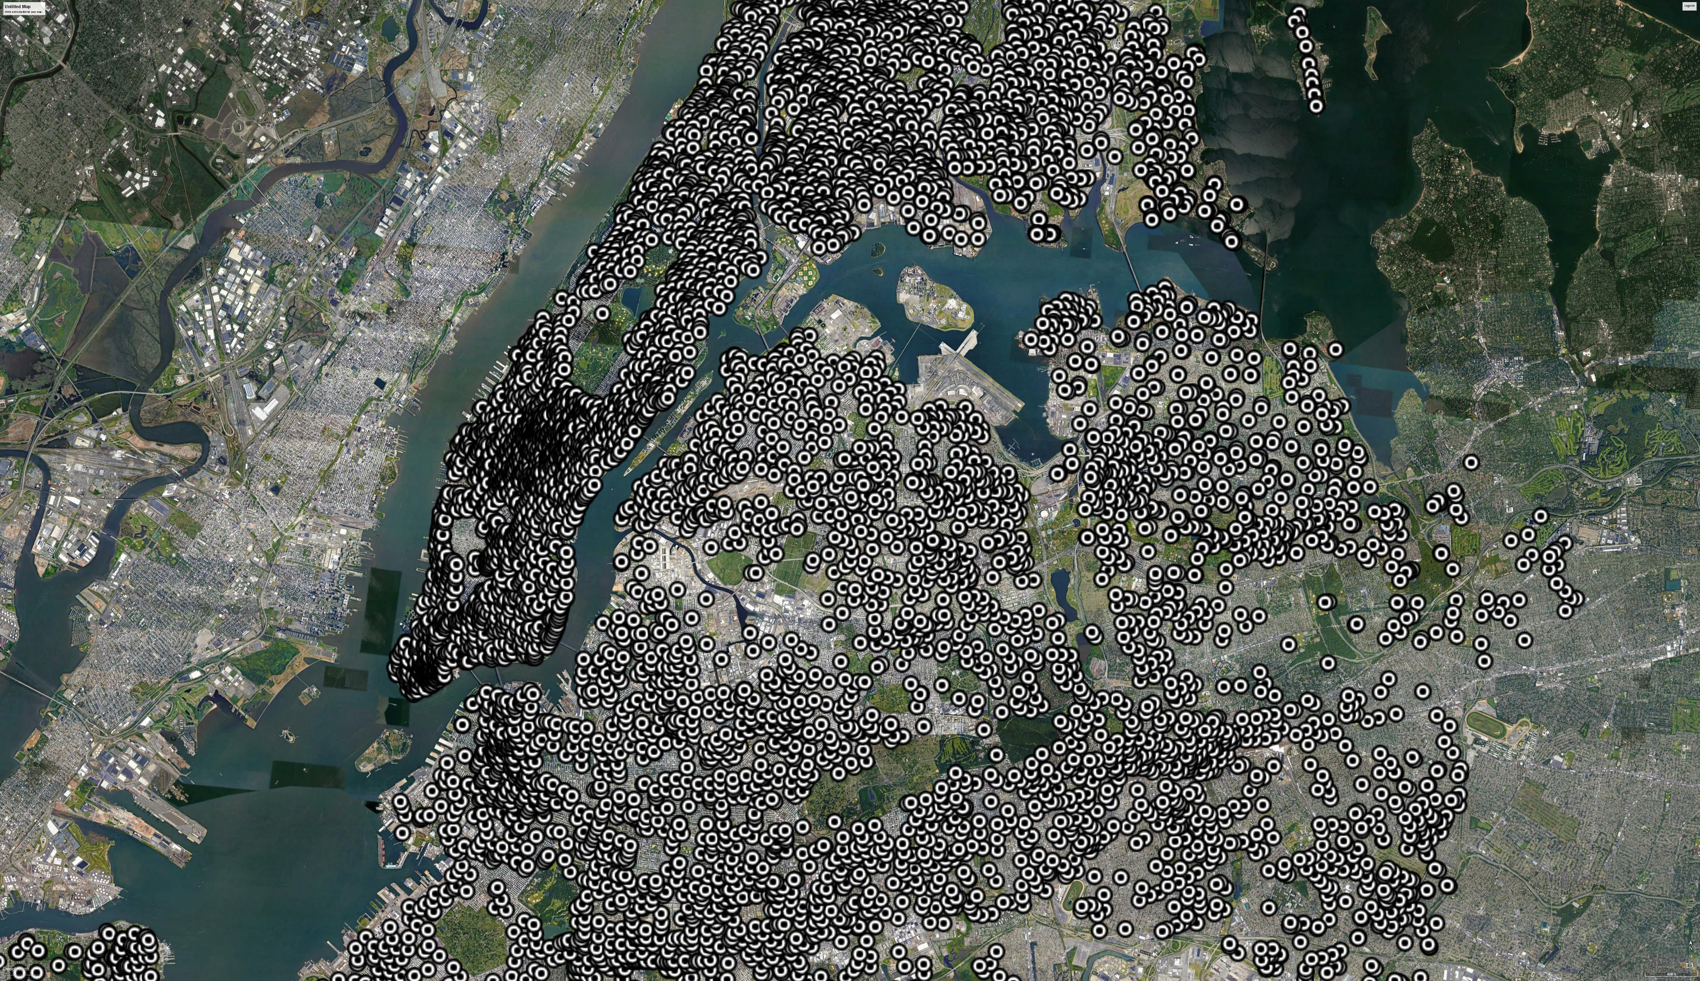


Can You Hear
Me Now?
Telecommunications
Strategies 2020 and Beyond

Slide 2




It's Just a Pole
SMALL BUT MIGHTY
CELL LOCATION
key players in enabling 5G are low-power antennas known as small cells and DAS (distributed antenna systems).
Population Density
Proximity to Fiber Optic Lines
Height and Line of Sight
Ramsay Richardson
Project Manager
15+ years experience managing telecommunications construction projects for major carriers as well as key mobile telecommunications franchises.
DAS systems allow them to support more than one service provider
Notes:
hello

Slide 3
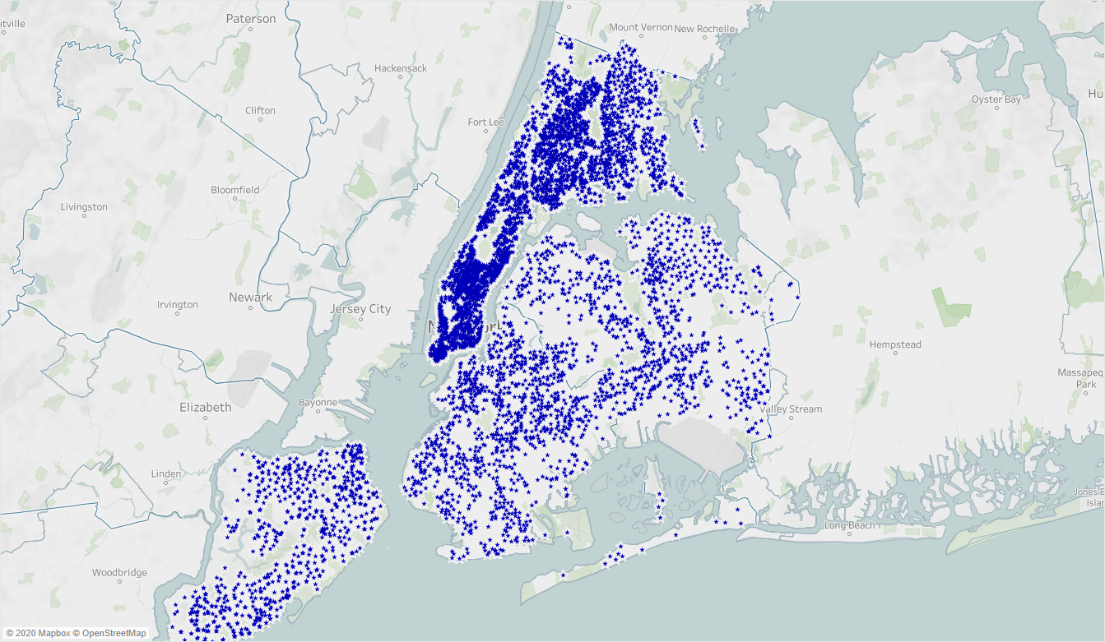
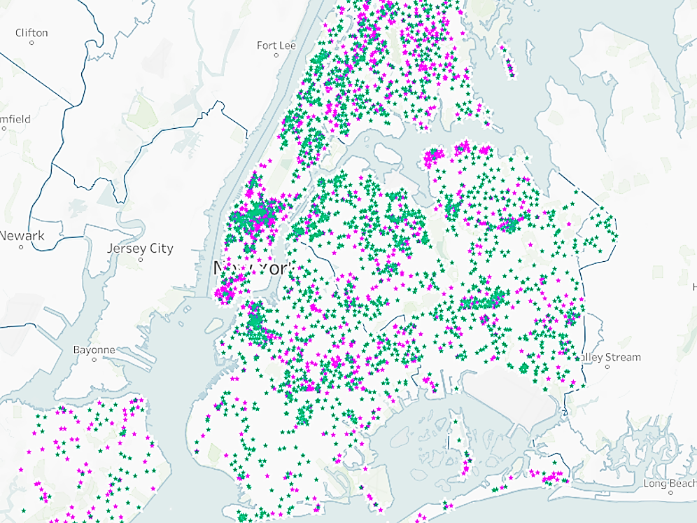
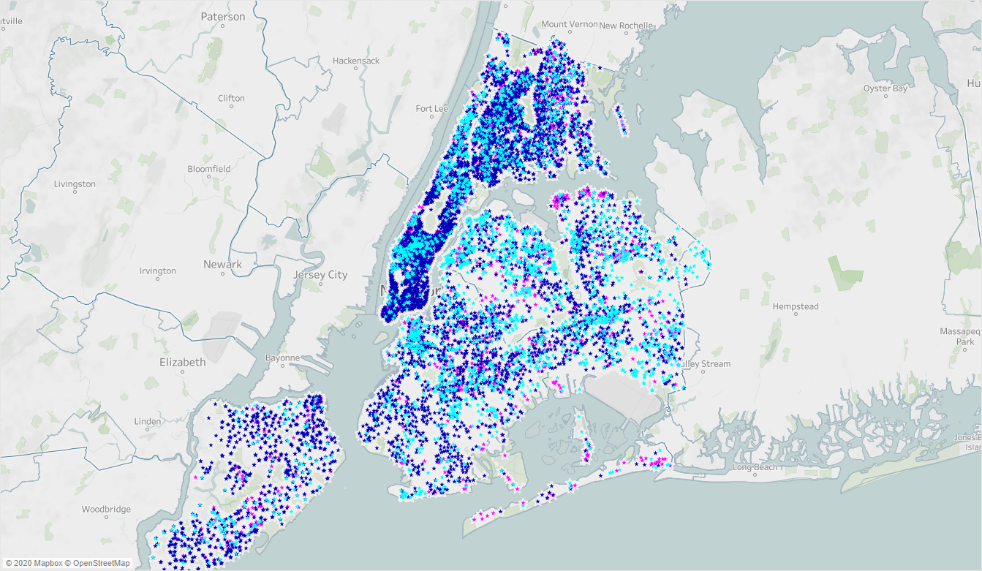




Installed
Pole Locals
Approved
&
Proposed
Pole Locals
4
The Dataset
Franchises
which lease pole space to major mobile carriers
198
Neighborhoods
across the 5 boroughs
9,282
Locations of street light, traffic light and utility poles authorized by the NYC Dept. of Information Technology and Telecommunications for the installation of mobile telecommunications equipment.
Notes:
gflhqghqhghPGHH

Slide 4

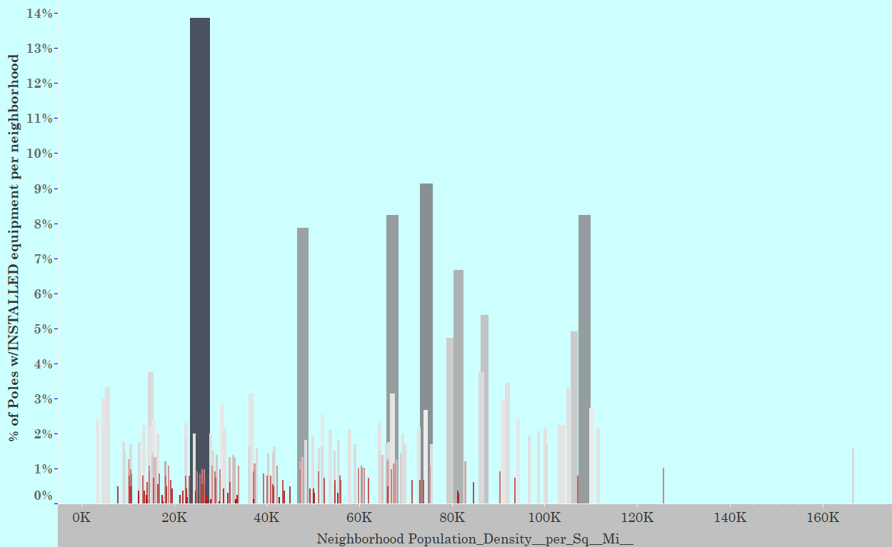
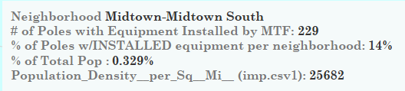
Current Franchise Market Strategy
Poles with equipment INSTALLED in relation to Neighborhood Pop Density

Slide 5



THE SHIFT
COVID ARRIVED
HOW DO WE MEET THIS CHALLENGE?
This unprecedented epidemic has forced individuals and companies alike to restructure pathways to success pertaining to every facet of life
INCREASED DEPENDENCY ON OUR DEVICES
Meet the people where they are.
We must pivot to amplify the service to residential clusters.
phones, laptops = the new workplace
allowing us the freedom to work remotely. With dropped calls and spotty reception, the strain on these resources shows

Slide 6
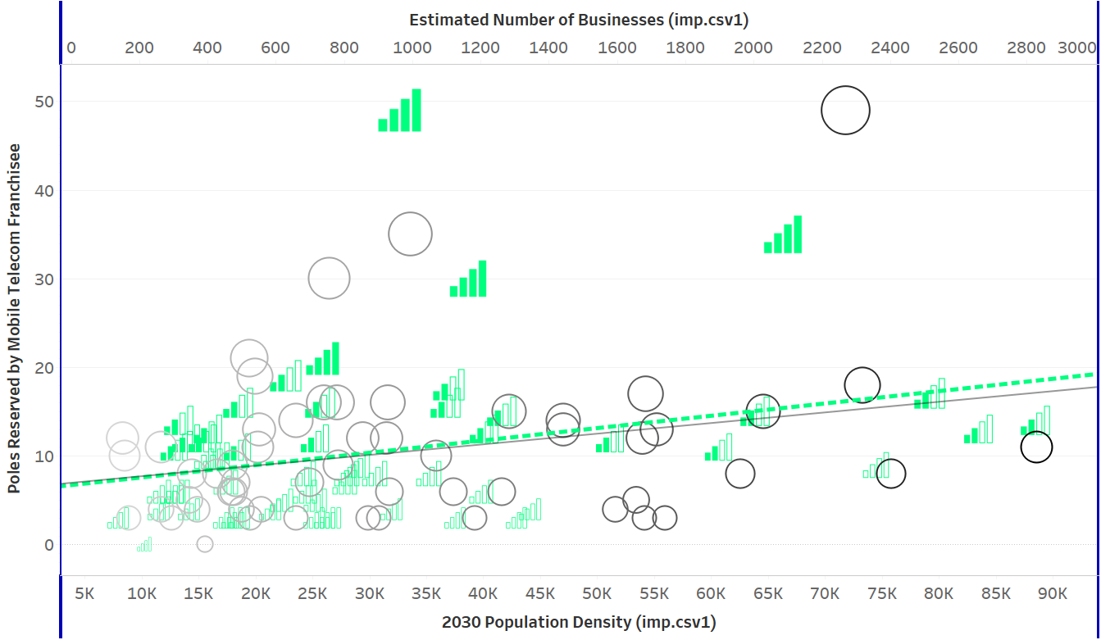
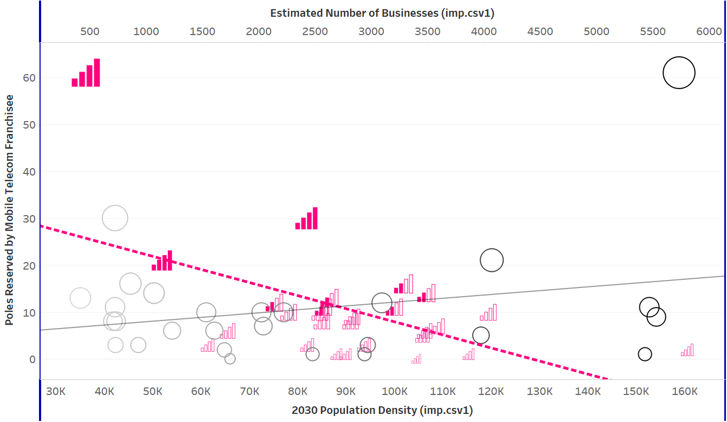
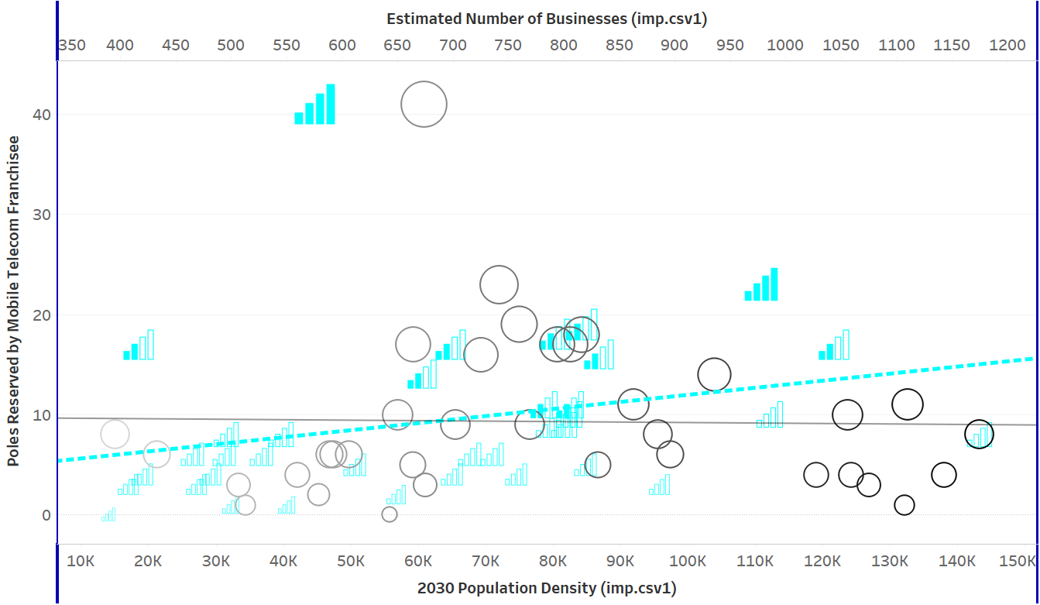
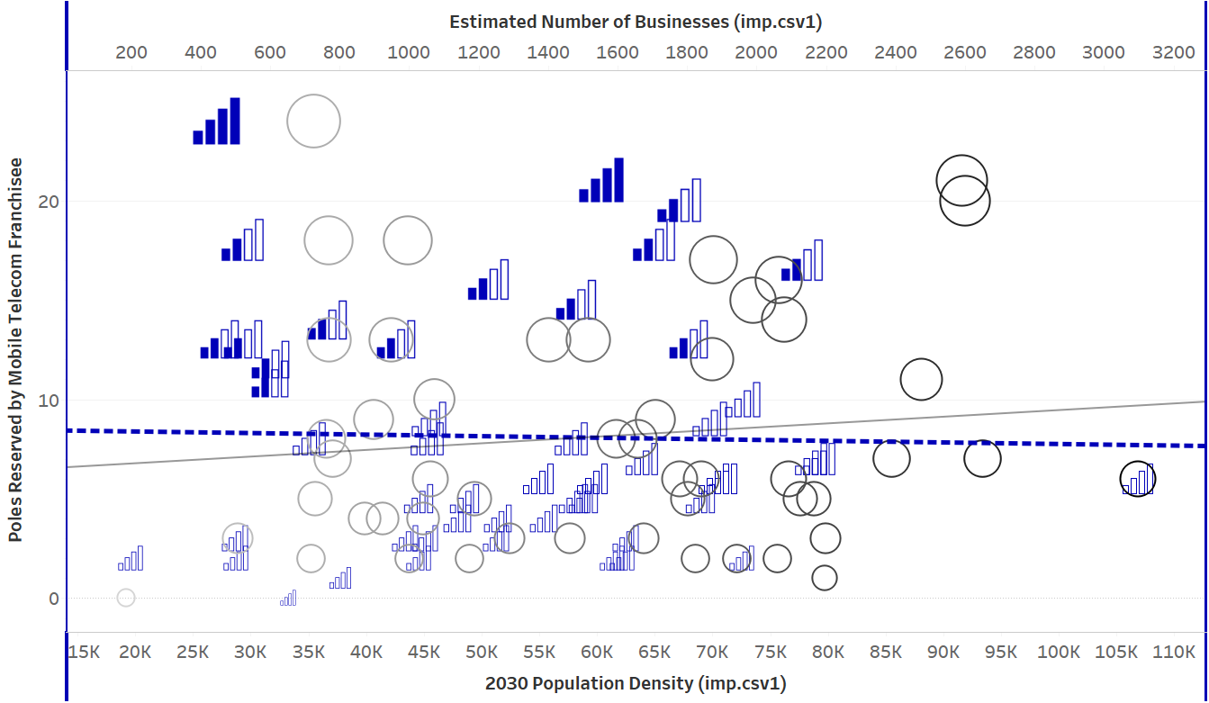
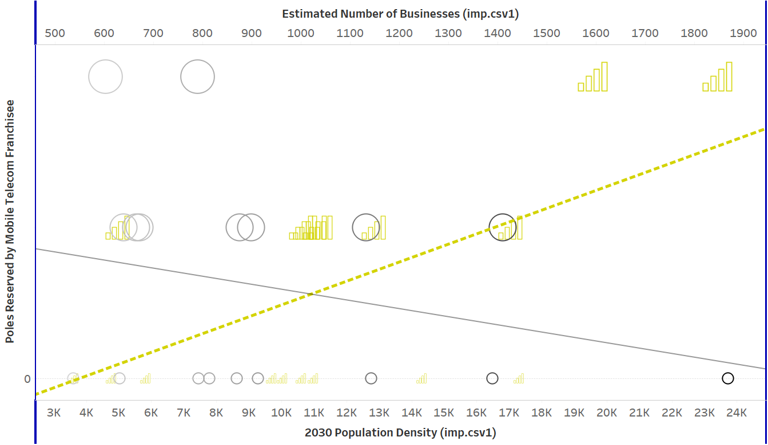
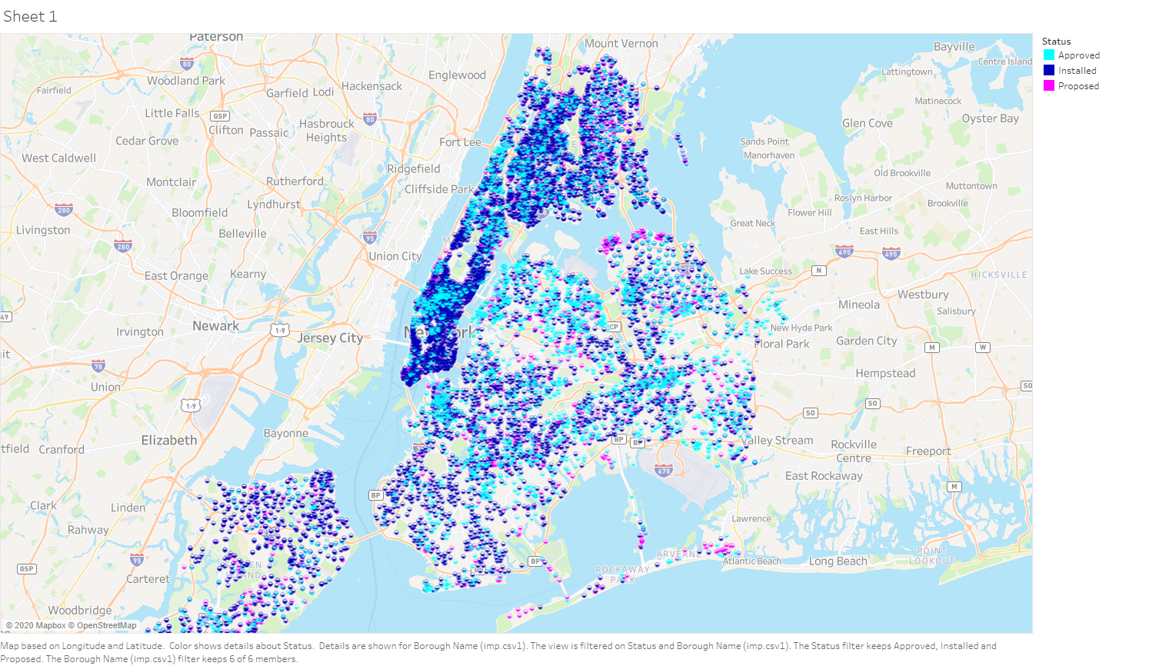
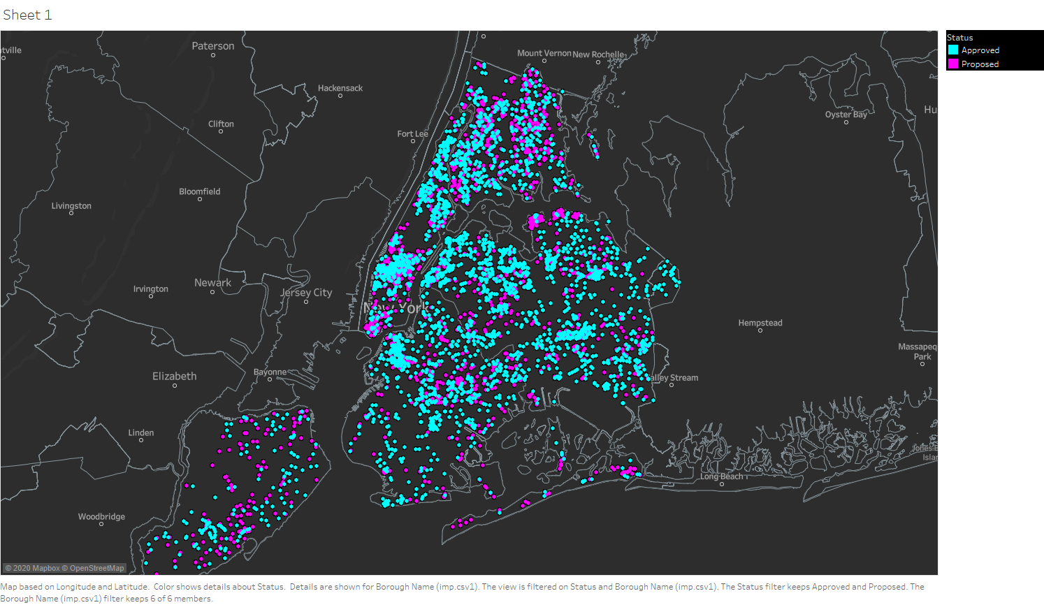
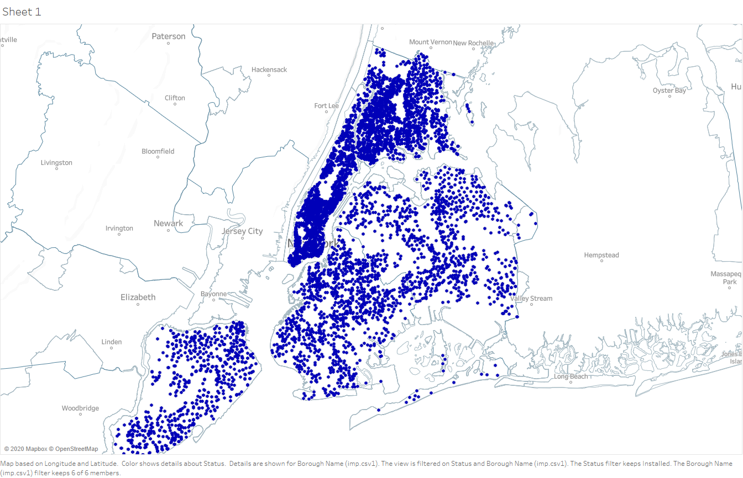
Queens and Staten Island follow the residential cluster trend
Manhattan, Brooklyn and the Bronx must pivot to serve residential areas

Slide 7
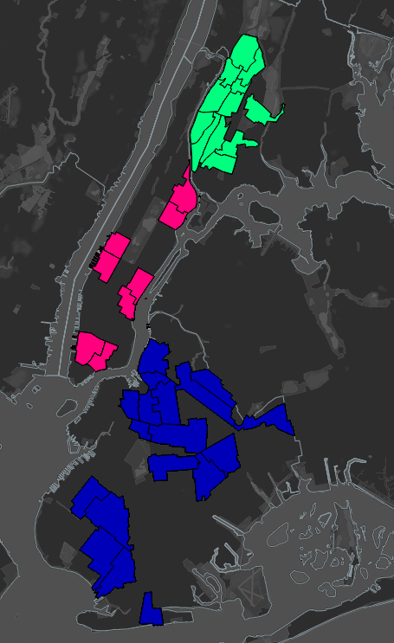
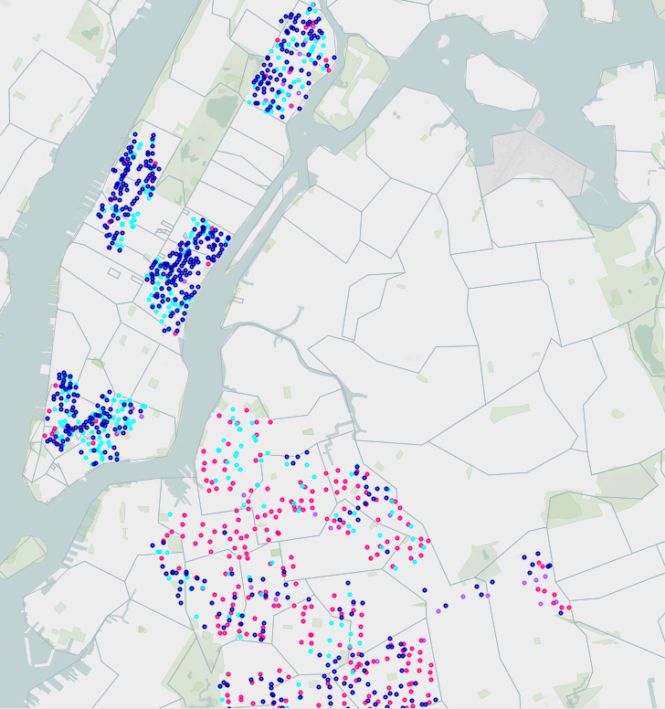
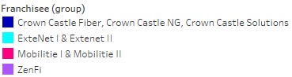
High Growth Neighborhoods of 2030
Identified by having over increase in pop of 3622 +

Slide 8
Find other elements that will strengthen the probability of my model currently at approximately 44% accuracy
Re run model with updated numbers post Covid flight
Include RF Maps for greater signal strength accuracy and effects
Further steps

